Slide 1
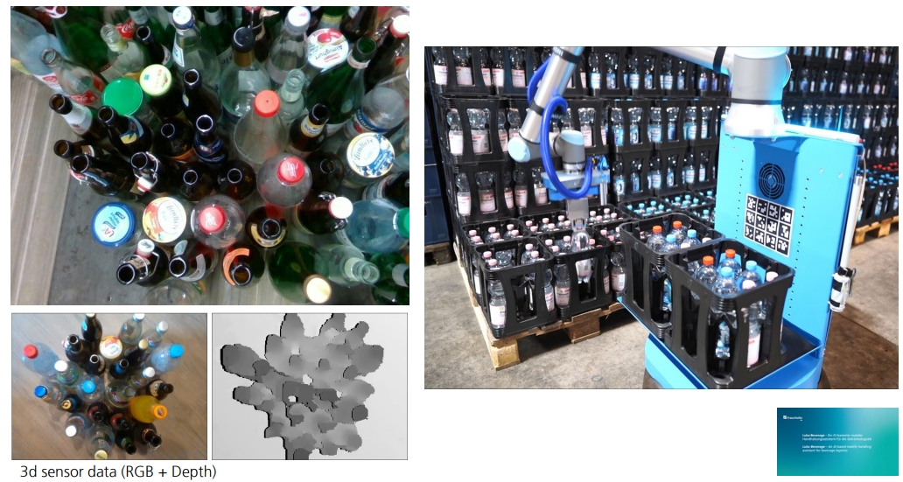
Laborprojekt Servicerobotik / Bildverarbeitung für Robotik 2025 Zwischenpräsentation Projekt 01: Bottle Detection
Bearbeiter: Mo Li/Xiang Ji/Chenghao Li
19.05.2025

Slide 2
Motivation
The aspect focuses on using deep learning techniques for the automated detection of bottle.
Why is this important?
It has practical applications in areas such as recycling, waste management, and automated sorting systems. Efficient classification of bottles can lead to better resource management, reduce waste, and promote sustainable practices. Moreover, using models like YOLO can significantly improve the speed and accuracy of the classification process in real-time environments.
We plan to perform bottle classification using the YOLO model, which includes tasks such as data preprocessing, model training, evaluation, and improvement. Additionally, we plan to enhance the model's performance by applying techniques like data augmentation and fine-tuning network parameters to improve classification accuracy.

Slide 3
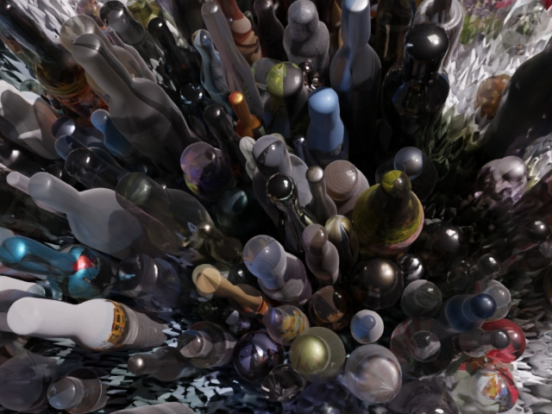
Stand der Implementierung
Current progress: Load the dataset (convert 3D data to 2D) + Preprocess the dataset + Data augmentation + Try training the model using YOLO
Current challenge: How to improve training accuracy?
Not started yet: The trained model has not been tested

Slide 4
Stand der Implementierung
Xiang Ji & Chenghao Li: Dataset processing + model training
Mo Li: Model testing + report writing
There are currently no unexpected difficulties, and the project is progressing according to plan.

Slide 5

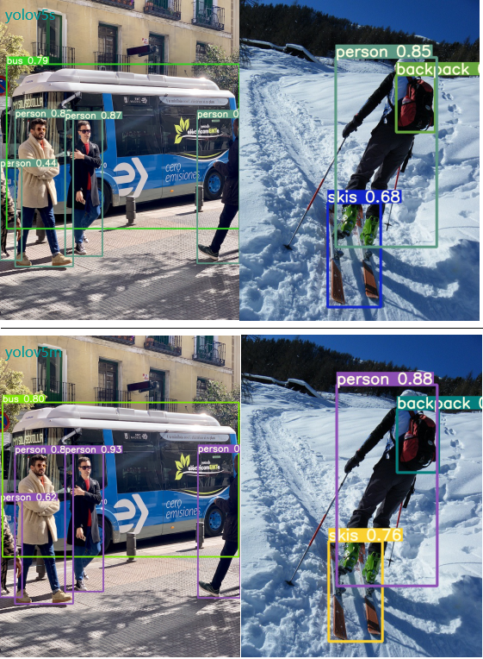
Main Approach
🔧 Key Features
High detection accuracy
Lightweight design
More stable training
Multi-task support

Slide 6
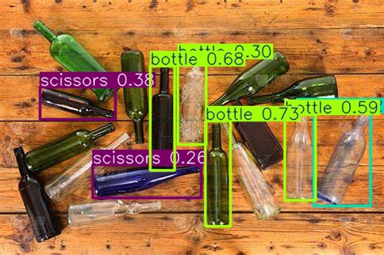
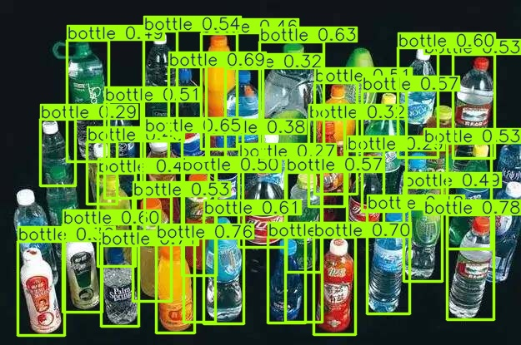
Implementation
As a first step, we have successfully set up the YOLO environment.
In the second step, We tried to directly process online images using the YOLO model.

Slide 7
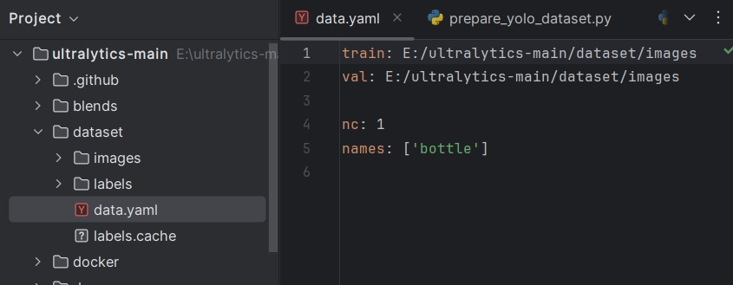
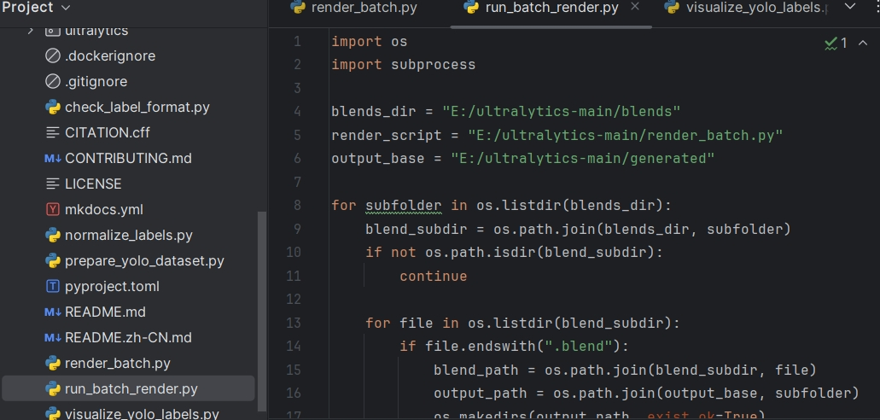
Implementation
Thirdly, we organized the data provided to us, with the steps:
Combine the gt file with the camera intrinsic parameters K and perform normalization,
Organize the data into a single dataset,
Attempt data augmentation using 3D files, etc.

Slide 8
Geplante Experimente und Auswertung
Next steps :
1. Data augmentation
2. train the model
3. evaluate the results

Slide 9
Geplante Experimente und Auswertung
The following aspects will be evaluated:
Classification accuracy (precision, recall, F1-score)
Loss functions during training
Detection speed and performance in real-time
Confusion between bottle types (confusion matrix)
Robustness under different lighting conditions or backgrounds

Slide 10
Current results
First, we have completed the pre-training of the YOLO model using the training set provided on the website.

Slide 11
Current results

Slide 12
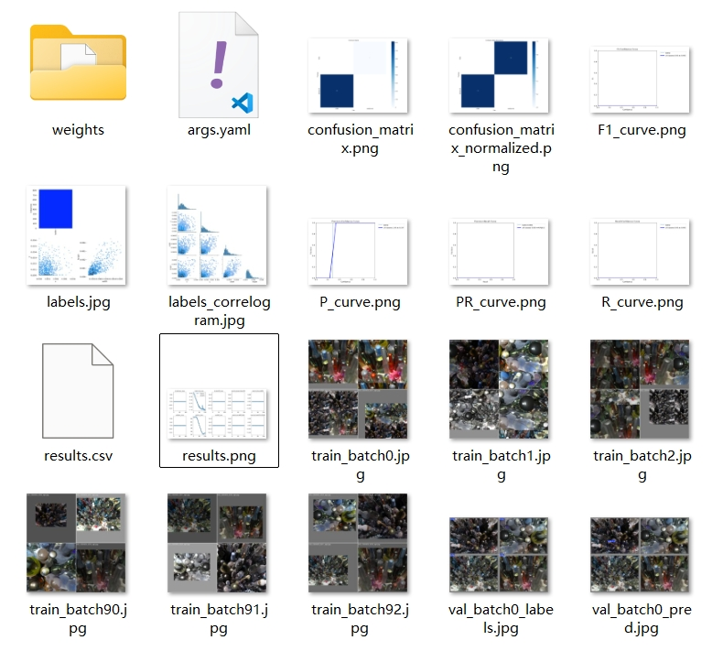
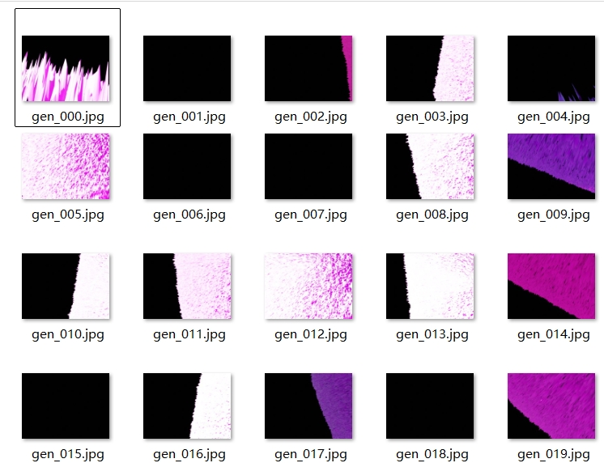
Current results

